Slide 1

OpenMP for Python
Caleb Huck
Notes:
Hey everyone, the topic for my term paper was the same thing I’ve been working on for my master’s project, and that is implementing core OpenMP in python.

Slide 2

Organization
Add later
Notes:
A little background. You all know that parallel computing is the norm today, not just for HPC, but for everything. And because of this, it has become a necessity for CS graduates to have at least some experience with parallel programming and parallel concepts. You all have probably heard about the iPDC workshops. It’s a program that Dr. Ghafoor heads up here at Tech where professors learn how to incorporate parallelism in their curricula. These are usually professors who teach early CS 0, CS 1 CS 2 classes so the point is to start teaching parallelism early in the coursework.

Slide 3
Background
Multi-core computing has become the standard
Parallel Programming skills essential
Multiprocessing
Shared-memory multithreading
Core 1
Core 2
Core 3
Core 3
Core 4
Thread 0
Thread 0
Thread 1
Thread 0
Thread 2
Notes:
A little background. You all know that parallel computing is the norm today, not just for HPC, but for everything. And because of this, it has become a necessity for CS graduates to have at least some experience with parallel programming and parallel concepts. You all have probably heard about the iPDC workshops. It’s a program that Dr. Ghafoor heads up here at Tech where professors learn how to incorporate parallelism in their curricula. These are usually professors who teach early CS 0, CS 1 CS 2 classes so the point is to start teaching parallelism early in the coursework.

Slide 4
Background
Industry
Demand for parallel programming skills
Academia
Parallel concepts taught earlier in curriculum [1-12]
Elective Requirement
Integrated with existing core classes
Notes:
A little background. You all know that parallel computing is the norm today, not just for HPC, but for everything. And because of this, it has become a necessity for CS graduates to have at least some experience with parallel programming and parallel concepts. You all have probably heard about the iPDC workshops. It’s a program that Dr. Ghafoor heads up here at Tech where professors learn how to incorporate parallelism in their curricula. These are usually professors who teach early CS 0, CS 1 CS 2 classes so the point is to start teaching parallelism early in the coursework.

Slide 5
Background
iPDC (Integrating Parallel and Distributed Computing in Introductory Programming Classes)
Provide parallel teaching material and resources
Workshops for professors (CS 0, 1, 2)
Lecture
Hands on exercises
Notes:
A little background. You all know that parallel computing is the norm today, not just for HPC, but for everything. And because of this, it has become a necessity for CS graduates to have at least some experience with parallel programming and parallel concepts. You all have probably heard about the iPDC workshops. It’s a program that Dr. Ghafoor heads up here at Tech where professors learn how to incorporate parallelism in their curricula. These are usually professors who teach early CS 0, CS 1 CS 2 classes so the point is to start teaching parallelism early in the coursework.

Slide 6


Slide 7
OpenMP
Open Multi-Processing (OpenMP)
Shared-memory parallel library
Removes responsibility for thread creation and management from programmer
Abstract preprocesor-level directives and clauses
Rewrites source code before compiler sees it
Runtime library
#pragma omp parallel
{
/*parallel code block*/
}
Notes:
OpenMP or Open Multiprocessing is one of the tools used to teach these concepts. OpenMP is a framework for shared-memory parallelism, and the biggest advantage in terms of teaching is that it removes responsibility from the programmer for thread creation and management. Instead, they describe how the code should be run using high level directives and clauses and the code is transformed by the preprocessor into the threaded code. Also, there is a runtime library that makes different function calls available to the programmer.

Slide 8
Problem
Top three languages used in teaching early CS:
C/C++
Java
Python
OpenMP only supports FORTRAN, C, C++
Several Java implementations with varying usability (covered later)
No implementations in Python
Notes:
So, what is the problem? Right now, the top three languages used for teaching early CS classes is C or C++, Java, and Python. Each one makes up about a third. Out of these, OpenMP only supports C/C++. There have been a few projects that implemented OpenMP in Java with varying levels of success. But to our knowledge, there haven’t been any attempts to bring OpenMP to Python.

Slide 9
Contribution
Core OpenMP functionality in Python
Directives and clauses
Runtime library
Teaching, not performance
Concurrency
Parallelism
Speedup
Efficiency
Synchronization
Etc.
Thread 0
Thread 0
Thread 1
Thread 0
Thread 2
Notes:
So that is what we have been working on. Implementing core OpenMP directives and clauses as well as a runtime library, for python. And I want to emphasize that our solution targets being a useful teaching tool, not a real-world performance library. If performance was a primary concern, then we would just write it in C anyway, right? So, the whole purpose of this project is to provide the same benefits of OpenMP for teaching parallel concepts, like concurrency, parallelism, speedup, efficiency, synchronizing, but to have it in python.

Slide 10
OpenMP Core
Directives | Clauses | Runtime Functions
parallel | num_threads | omp_get_thread_num()
for | reduction | omp_get_num_threads()
parallel for | shared | omp_get_wtime()
barrier | private
critical | firstprivate
 | lastprivate
Notes:
So, these are the directives, clauses, and runtime functions that we consider part of the essential OpenMP Core. It’s a little bit subjective and I won’t cover all of these specifically, but our idea was to include the stuff from OpenMP that makes up most of the common functionality. So even if we don’t implement everything, we have enough to write pretty much any parallel algorithm.
*subjective grouping

Slide 11
Related Work
Jomp [14]
Released in 2000
Java 1.x and OpenMP version 1.0
Two phase compilation (.jomp .java .class)
Pyjama [15]
Released in 2013
Java 7 and OpenMP 4.x
Two phases combined to single application (.java .class)
Omp4J [16]
Released in 2015
Java 8 and OpenMP 4.x
Similar to Pyjama
No runtime library
Notes:
As I mentioned, there have several projects in the past porting OpenMP to Java. The first was Jomp in 2000. To use jomp, the user would write their code in a .jomp file, which was regular java code with OpenMP directives and clauses as comments. Then you had to run it through their preprocessor which would create the corresponding java files. You could then run javac to compile to class files and then run the program normally. Pyjama made this process a little simpler by combining the preprocessor and compilation so that class files could be generated in one step instead of two. Omp4j worked similarly to Pyjama but did away with the runtime library. Each of these had their own problems, falling short in terms of usability. Out of the three, Pyjama has been the best and most usable and is the one currently used in the Java portion of the iPDC workshop.

Slide 12
Design
Design Goals
Easy to use
Provide helpful error messages for debugging
Integrate with IDEs
Following original OpenMP syntax/style
Notes:
So, we learned quite a bit from the Java versions and even though Python is a different language, we draw a lot of our design goals from our experience with them. Four of our main goals are to be easy to use, particularly for newer students in early CS classes; provide helpful error messages, which was a frustrating problem in the java versions because you would get errors from the transformed code that didn’t make sense because it wasn’t from the code that the programmer wrote; we want our solution to work well with IDEs and different environments; and lastly, we want to mimic the original OpenMP syntax and style as closely as possible.

Slide 13

Python-Related Obstacles
Problem
Solution
GIL (Global Interpreter Lock)
Jython Interpreter
Notes:
As you can imagine, we had a few problems making OpenMP work in Python. The first and most obvious being the global interpreter lock. In CPython, which is the most used interpreter, anytime a thread accesses any shared resource, the interpreter is locked for all other threads. This helps prevent things like race conditions, but it also effectively serializes your multithreaded code. To solve this problem, we use the jython interpreter. Jython is a java-based interpreter that was implemented without a GIL and uses java threads under the hood. Another problem we faced had to do with data structures. In C, we use arrays a lot with OpenMP. But in python, there is no primitive array type, instead we have list objects. And the problem with lists is that even in jython, they are automatically locked for both reading and writing, even to different index locations in the list. We found a partial solution to this problem. Jython includes a module called jarray that has two classes, array and zeros. These basically create a java array wrapped in an object with almost identical member functions to lists. Using these we can at least get parallel reading from the array, but writing is still serialized unfortunately. Lastly, in python, there is no way to define an arbitrary new scope. In C you can use curly braces to create a new scope wherever you want, but in python there is no syntax to do that. To fix this, we changed the python syntax to allow an OpenMP comment to come before an indented block. The only downside to this is that we lose compatibility with any standard python interpreter if the code isn’t run through our preprocessor first, because it will appear as a comment followed by an indented block, which is obviously illegal. We felt it was worth it to make this compromise to keep consistent with python indentation with our OpenMP directives.

Slide 14
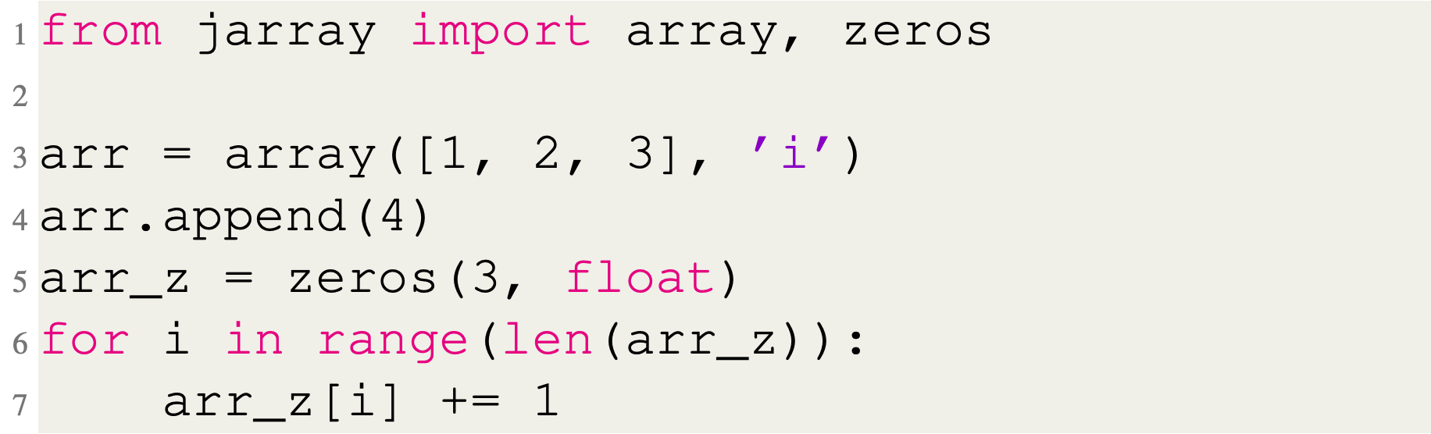
Python-Related Obstacles
Problem
Solution
jarray.array & jarray.zeros
Data Structures
Notes:
As you can imagine, we had a few problems making OpenMP work in Python. The first and most obvious being the global interpreter lock. In CPython, which is the most used interpreter, anytime a thread accesses any shared resource, the interpreter is locked for all other threads. This helps prevent things like race conditions, but it also effectively serializes your multithreaded code. To solve this problem, we use the jython interpreter. Jython is a java-based interpreter that was implemented without a GIL and uses java threads under the hood. Another problem we faced had to do with data structures. In C, we use arrays a lot with OpenMP. But in python, there is no primitive array type, instead we have list objects. And the problem with lists is that even in jython, they are automatically locked for both reading and writing, even to different index locations in the list. We found a partial solution to this problem. Jython includes a module called jarray that has two classes, array and zeros. These basically create a java array wrapped in an object with almost identical member functions to lists. Using these we can at least get parallel reading from the array, but writing is still serialized unfortunately. Lastly, in python, there is no way to define an arbitrary new scope. In C you can use curly braces to create a new scope wherever you want, but in python there is no syntax to do that. To fix this, we changed the python syntax to allow an OpenMP comment to come before an indented block. The only downside to this is that we lose compatibility with any standard python interpreter if the code isn’t run through our preprocessor first, because it will appear as a comment followed by an indented block, which is obviously illegal. We felt it was worth it to make this compromise to keep consistent with python indentation with our OpenMP directives.

Slide 15
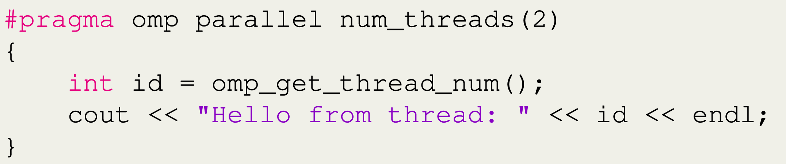
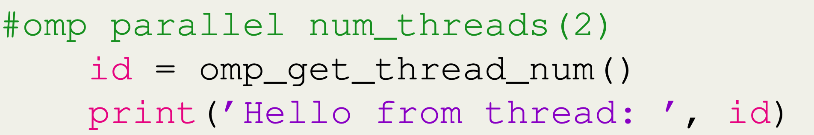
Python-Related Obstacles
Problem
Solution
Modify Python syntax
Scope
C++
Python
*Breaks compatibility with standard Python
Notes:
As you can imagine, we had a few problems making OpenMP work in Python. The first and most obvious being the global interpreter lock. In CPython, which is the most used interpreter, anytime a thread accesses any shared resource, the interpreter is locked for all other threads. This helps prevent things like race conditions, but it also effectively serializes your multithreaded code. To solve this problem, we use the jython interpreter. Jython is a java-based interpreter that was implemented without a GIL and uses java threads under the hood. Another problem we faced had to do with data structures. In C, we use arrays a lot with OpenMP. But in python, there is no primitive array type, instead we have list objects. And the problem with lists is that even in jython, they are automatically locked for both reading and writing, even to different index locations in the list. We found a partial solution to this problem. Jython includes a module called jarray that has two classes, array and zeros. These basically create a java array wrapped in an object with almost identical member functions to lists. Using these we can at least get parallel reading from the array, but writing is still serialized unfortunately. Lastly, in python, there is no way to define an arbitrary new scope. In C you can use curly braces to create a new scope wherever you want, but in python there is no syntax to do that. To fix this, we changed the python syntax to allow an OpenMP comment to come before an indented block. The only downside to this is that we lose compatibility with any standard python interpreter if the code isn’t run through our preprocessor first, because it will appear as a comment followed by an indented block, which is obviously illegal. We felt it was worth it to make this compromise to keep consistent with python indentation with our OpenMP directives.

Slide 16
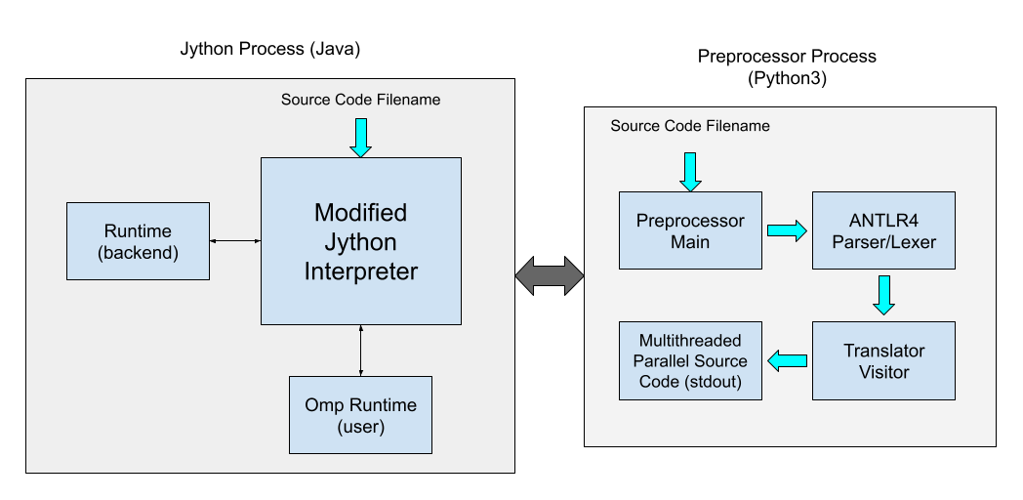
Software Architecture
Jython (Java) Process
Modified to call preprocessor before executing code
Backend runtime
User runtime
Preprocessor (Python 3) Process
ANTLRv4 Parser Generator
Visitor pattern
OpenMP Code Threaded Code
Transformed code/error printed to stdout
Notes:
Here is a quick overview of how the original code is transformed into threaded code. We use the ANTLRv4 parser generator to lex and parse the user’s code. Then our custom visitor traverses the AST and prints the transformed code to the SourcePrinter object. Because of some nice features in the way Python works, we are able to get all the information we need and transform the code in a single pass over the syntax tree. The output is the multithreaded code that depends on our backend runtime library. The backend runtime handles things like running parallel targets with the correct number of threads and managing OpenMP for loops and a few other things related to how the OpenMP blocks are executed. And then of course we have our user runtime that only has two functions for now, omp_get_thread_num() and omp_get_num_threads() which were on that slide from earlier.

Slide 17
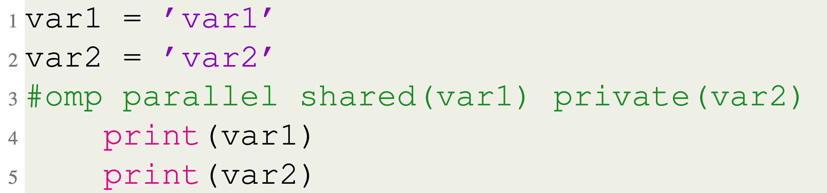
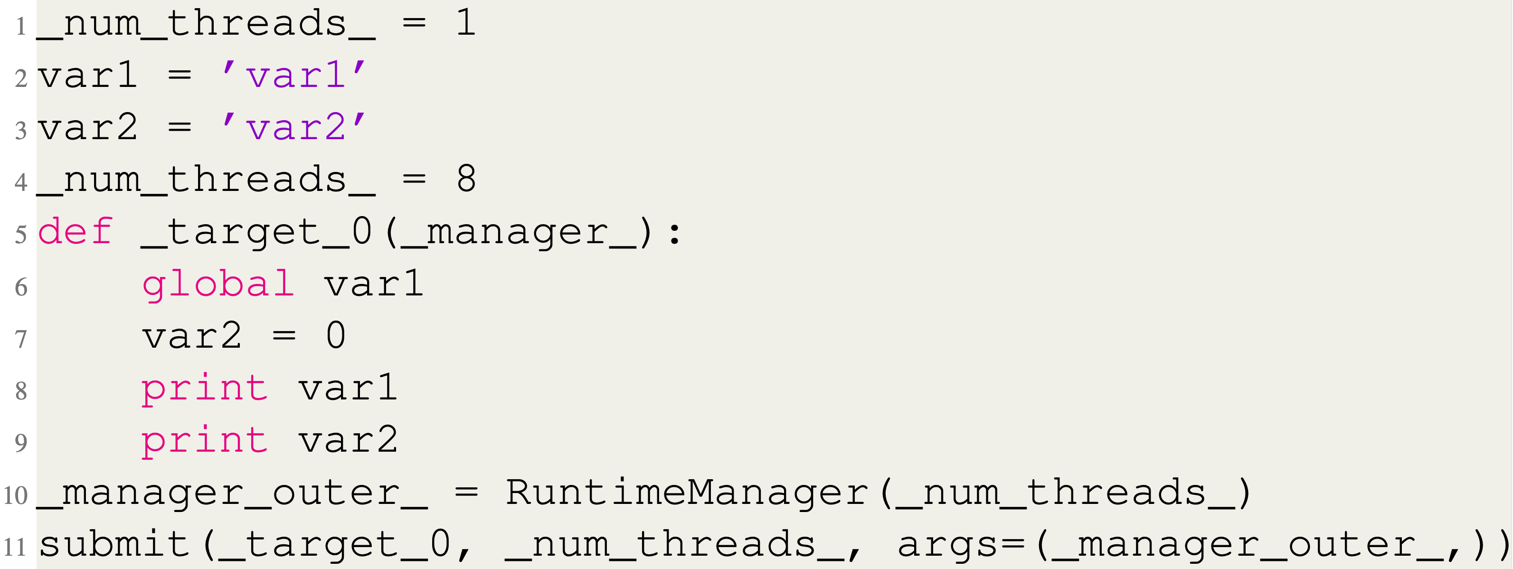
Source-to-source Translation
OpenMP Input Code
Preprocessor Output Code
Notes:
Here is a quick overview of how the original code is transformed into threaded code. We use the ANTLRv4 parser generator to lex and parse the user’s code. Then our custom visitor traverses the AST and prints the transformed code to the SourcePrinter object. Because of some nice features in the way Python works, we are able to get all the information we need and transform the code in a single pass over the syntax tree. The output is the multithreaded code that depends on our backend runtime library. The backend runtime handles things like running parallel targets with the correct number of threads and managing OpenMP for loops and a few other things related to how the OpenMP blocks are executed. And then of course we have our user runtime that only has two functions for now, omp_get_thread_num() and omp_get_num_threads() which were on that slide from earlier.

Slide 18
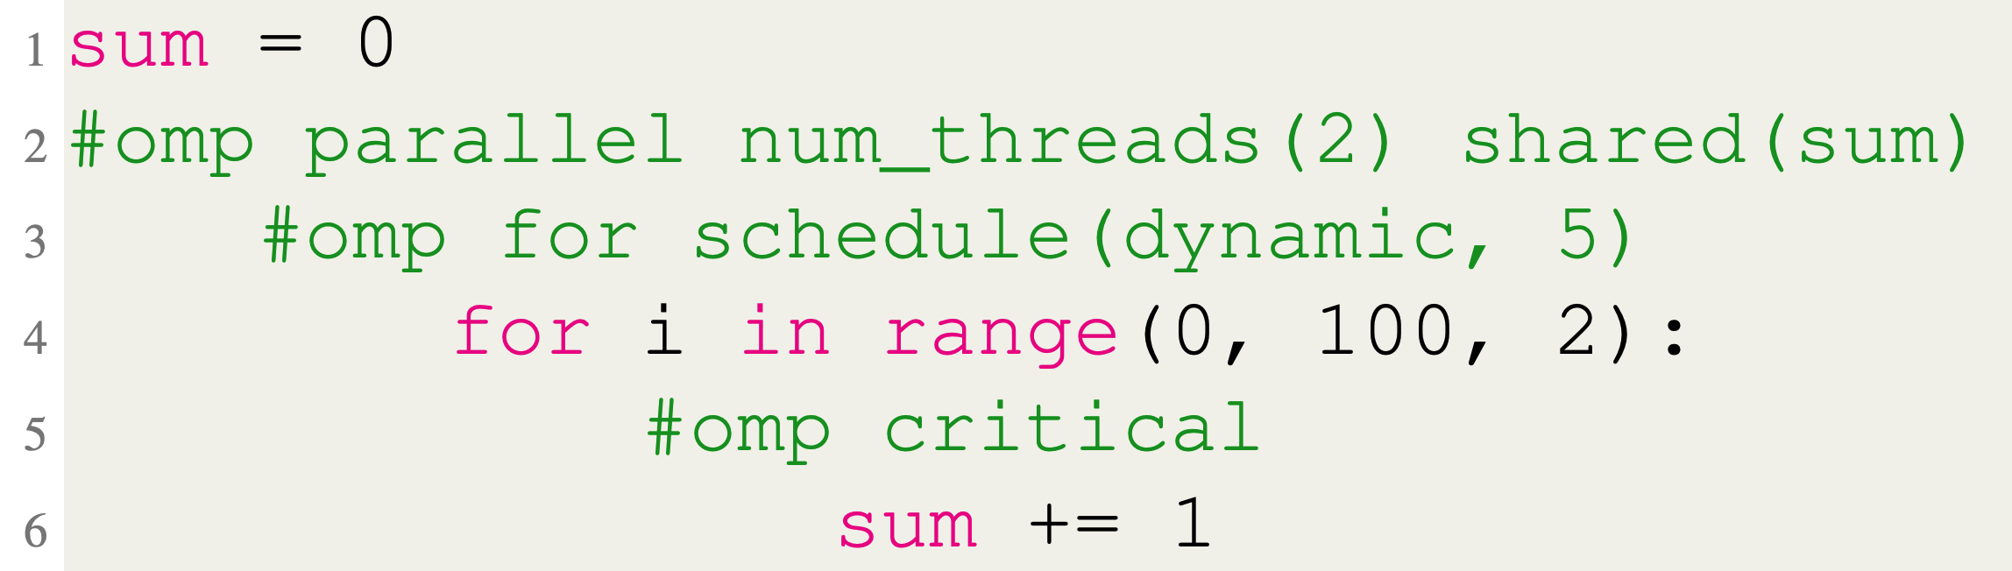
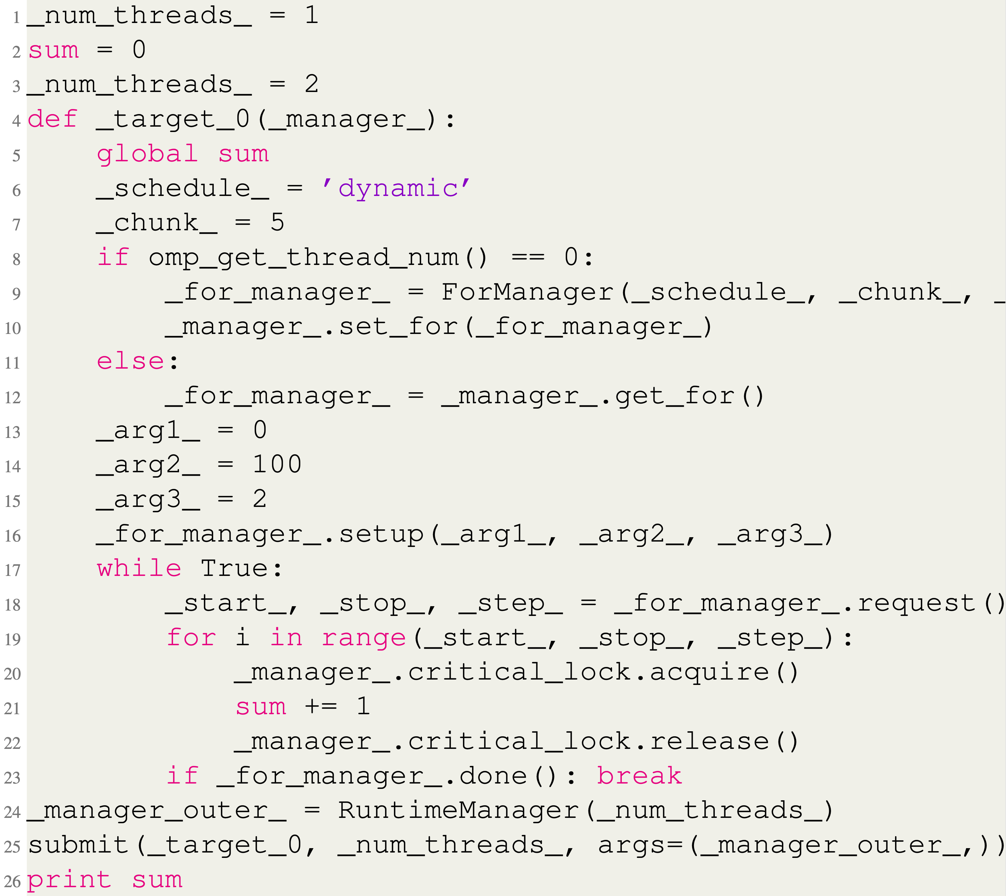
Source-to-source Translation
OpenMP Input Code
Preprocessor Output Code
Notes:
Here is a quick overview of how the original code is transformed into threaded code. We use the ANTLRv4 parser generator to lex and parse the user’s code. Then our custom visitor traverses the AST and prints the transformed code to the SourcePrinter object. Because of some nice features in the way Python works, we are able to get all the information we need and transform the code in a single pass over the syntax tree. The output is the multithreaded code that depends on our backend runtime library. The backend runtime handles things like running parallel targets with the correct number of threads and managing OpenMP for loops and a few other things related to how the OpenMP blocks are executed. And then of course we have our user runtime that only has two functions for now, omp_get_thread_num() and omp_get_num_threads() which were on that slide from earlier.

Slide 19
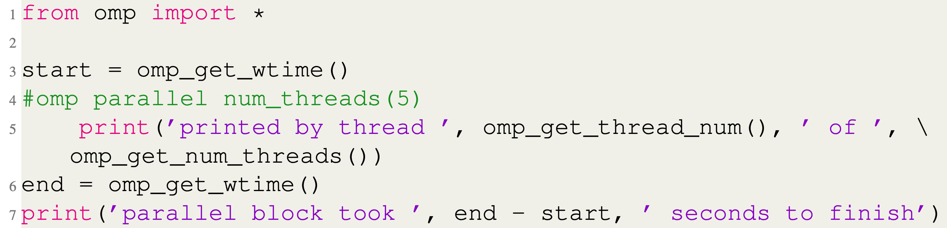
Runtime API
Notes:
Here is a quick overview of how the original code is transformed into threaded code. We use the ANTLRv4 parser generator to lex and parse the user’s code. Then our custom visitor traverses the AST and prints the transformed code to the SourcePrinter object. Because of some nice features in the way Python works, we are able to get all the information we need and transform the code in a single pass over the syntax tree. The output is the multithreaded code that depends on our backend runtime library. The backend runtime handles things like running parallel targets with the correct number of threads and managing OpenMP for loops and a few other things related to how the OpenMP blocks are executed. And then of course we have our user runtime that only has two functions for now, omp_get_thread_num() and omp_get_num_threads() which were on that slide from earlier.

Slide 20
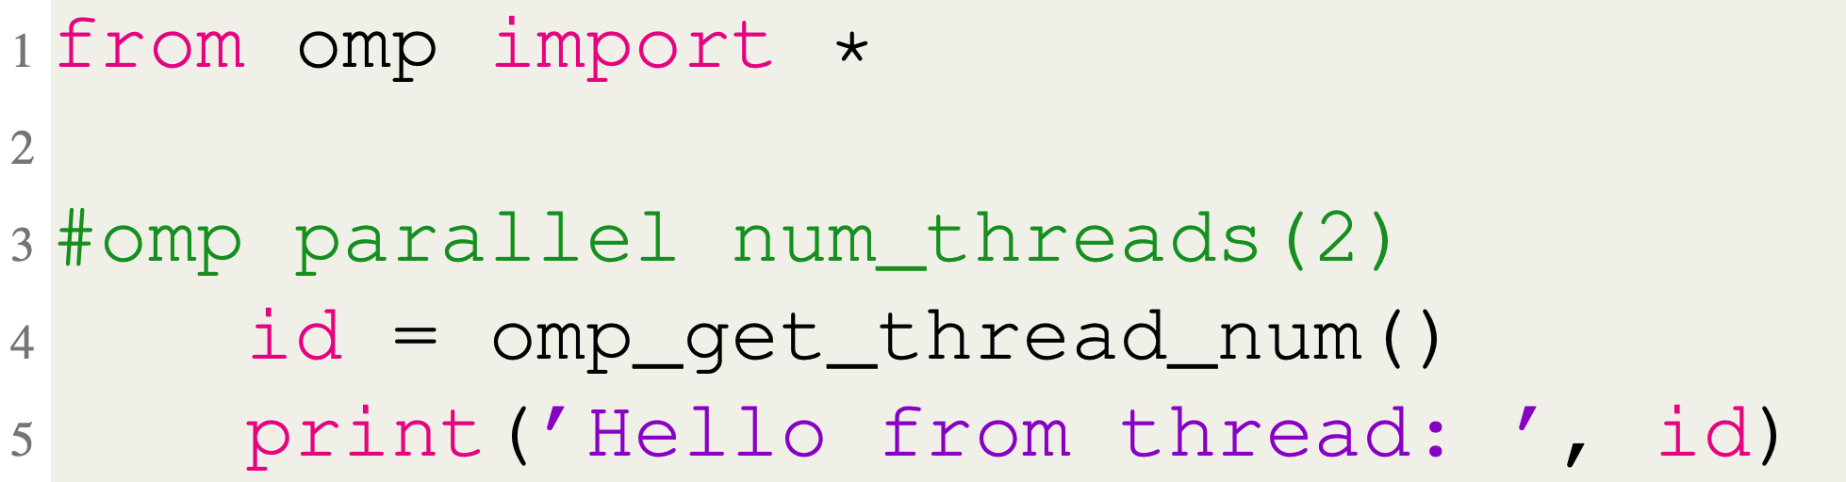
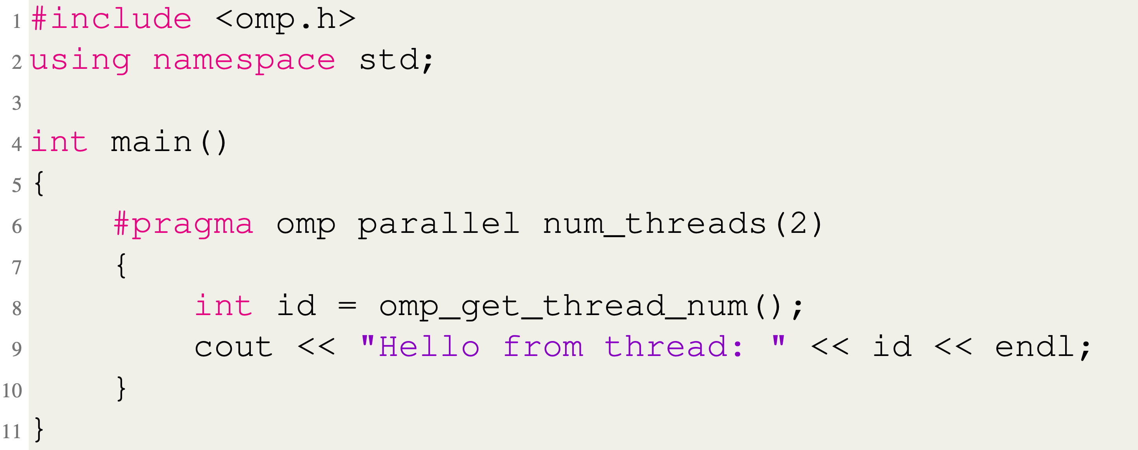
Parallel Directive
Python
C++
Notes:
Here is a quick syntax example of a basic parallel directive and the C++ equivalent. You can see that there is really just a lot less boilerplate code in the python version, but other than that they are almost identical.

Slide 21
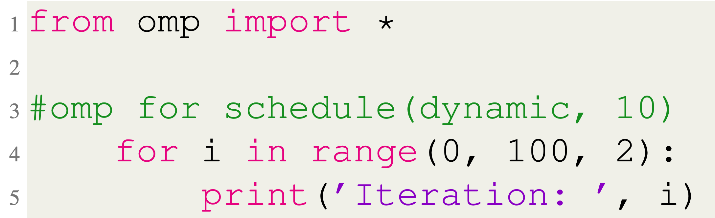
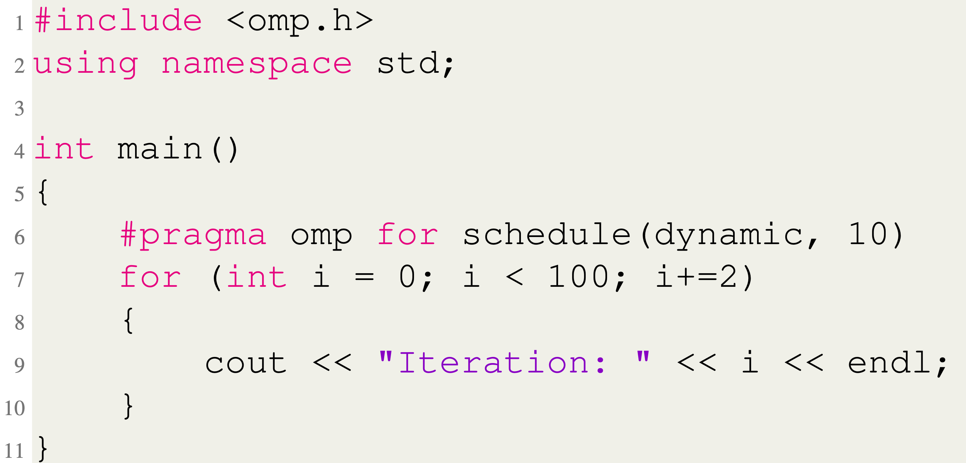
For Directive
Python
C++
Notes:
I also wanted to quickly cover the for directive. Python doesn’t have for loops like in C. Instead, it only has for-each loops. So, to deal with this, we put restrictions on the syntax of a for loop following a for directive. So, if you look at the example here, it starts with for, then a single variable, in, and then the next thing has to be range, and range can take 1, 2, or 3 parameters which basically correspond to the three parts of a C for loop. Here the range will be from 0 to 99, in increments of 2, so the output will be the same as the C++ loop below it. If there are only two parameters, then the third is assumed to be 1, and if there is only one parameter, then the range is assumed to start at 0 and go until whatever parameter is passed in increments of 1.

Slide 22
Performance
Microbenchmarks
Windows 10 machine
6 cores/12 hardware threads
Random integers
Average of 20 runs
Notes:
Okay so we tested our python OpenMP using a very simple benchmark, it’s just simple matrix multiplication between two square matrices. You all probably know this an embarrassingly parallel problem, which means that the work of each thread doesn’t depend on results from any other thread, their work is independent of each other. Also, no threads needs to write to the same memory location, although that’s only kind of true because of the way python data structures work as I talked about already. So, we ran the benchmark with 1, 2, 4, 6, 8, 10, and 12 threads with n equal to 100, 200, 300, 400, and 500.

Slide 23
Performance
Microbenchmarks
N x N Matrix Multiplication
Matrices stored in jarray
Row wise partitioning
1, 2, 4, 8, and 12 threads
Parallel Sum
Integers stored in jarray
Divided evenly among threads
1, 2, 4, 8, and 12 threads
* Results obtained using same OpenMP block for all runs, including 1 thread
Notes:
Okay so we tested our python OpenMP using a very simple benchmark, it’s just simple matrix multiplication between two square matrices. You all probably know this an embarrassingly parallel problem, which means that the work of each thread doesn’t depend on results from any other thread, their work is independent of each other. Also, no threads needs to write to the same memory location, although that’s only kind of true because of the way python data structures work as I talked about already. So, we ran the benchmark with 1, 2, 4, 6, 8, 10, and 12 threads with n equal to 100, 200, 300, 400, and 500.

Slide 24
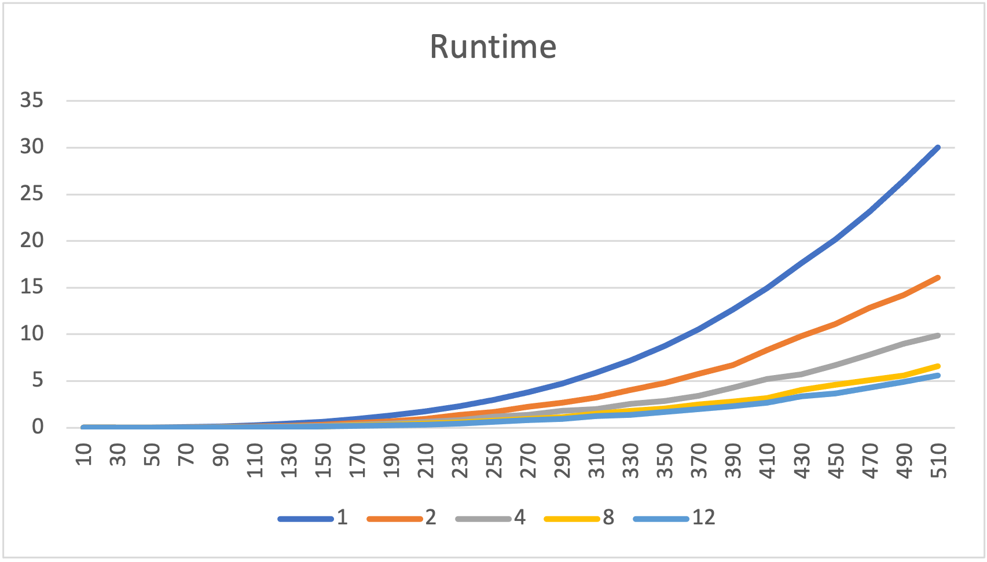
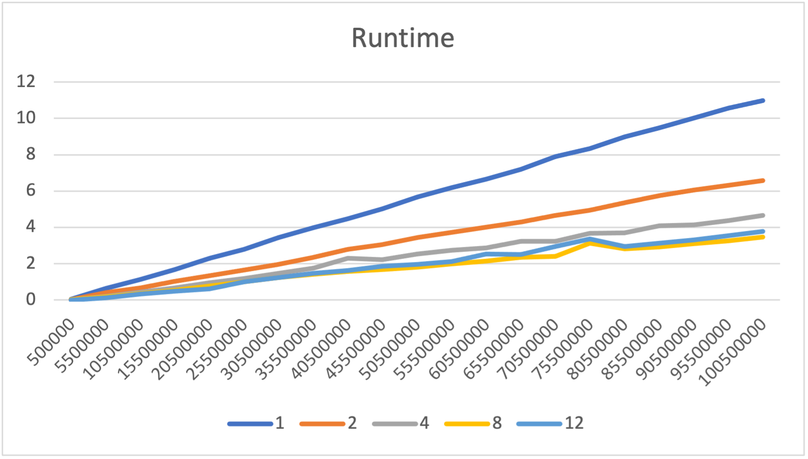
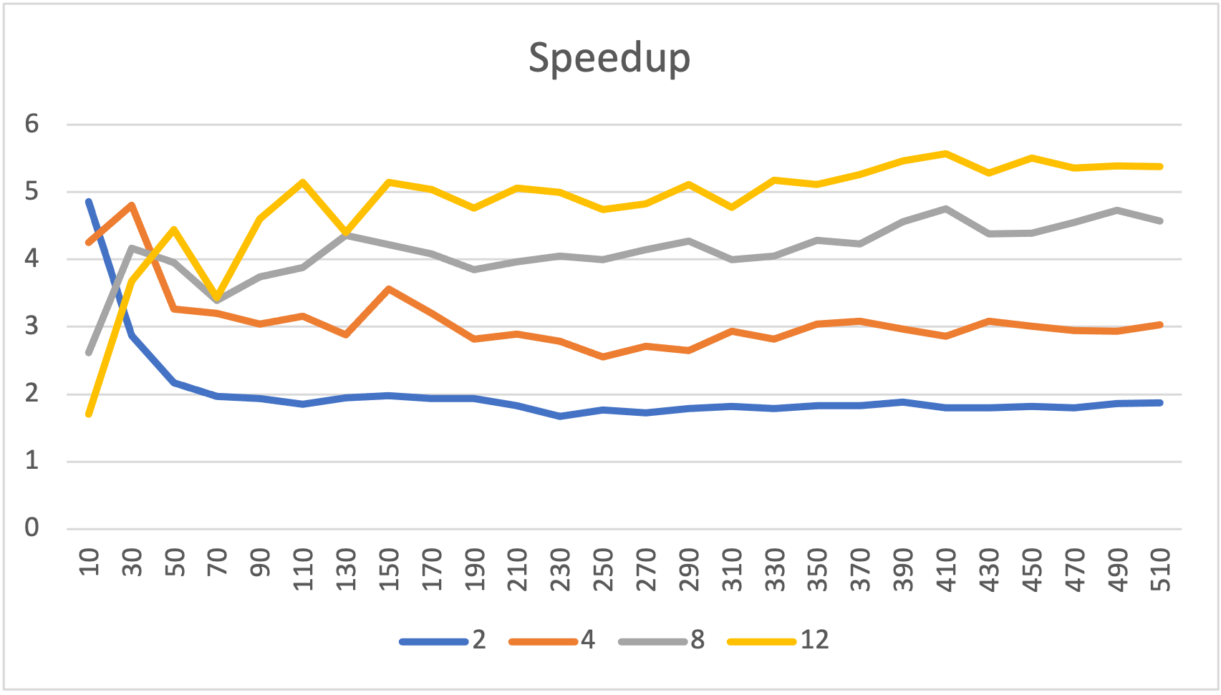
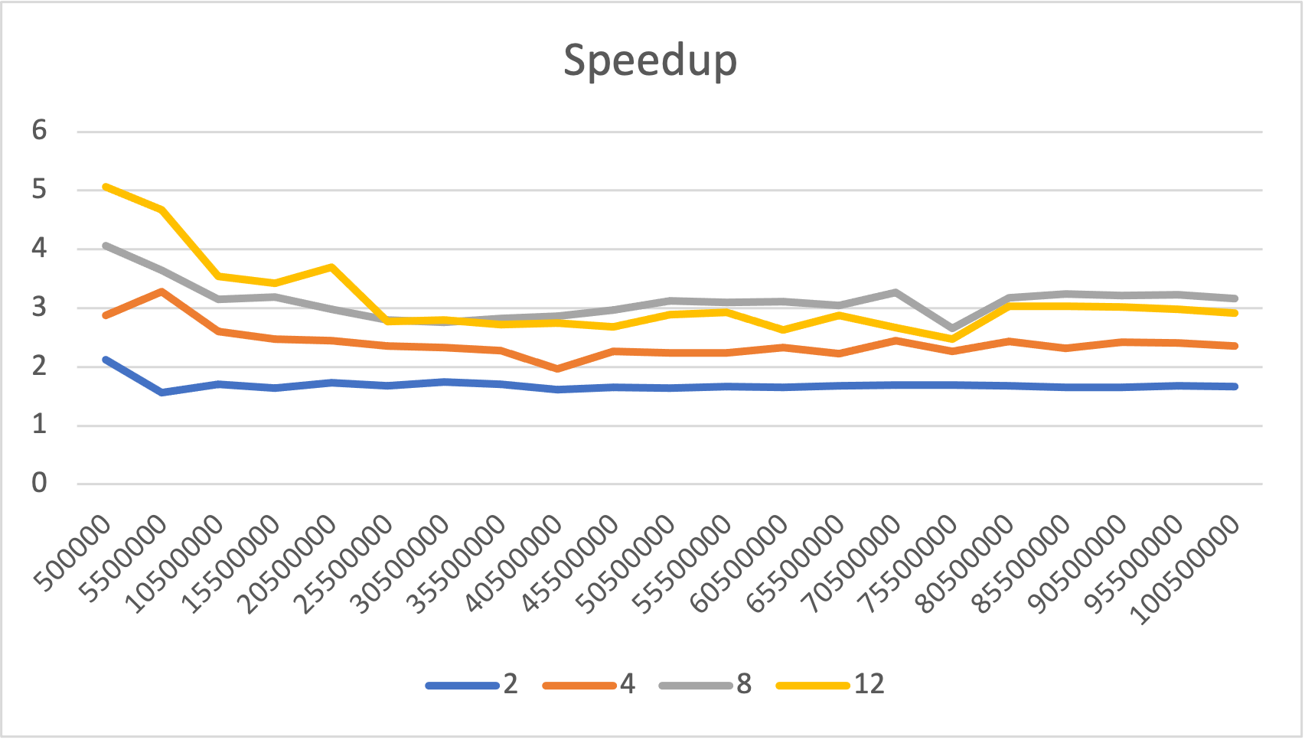
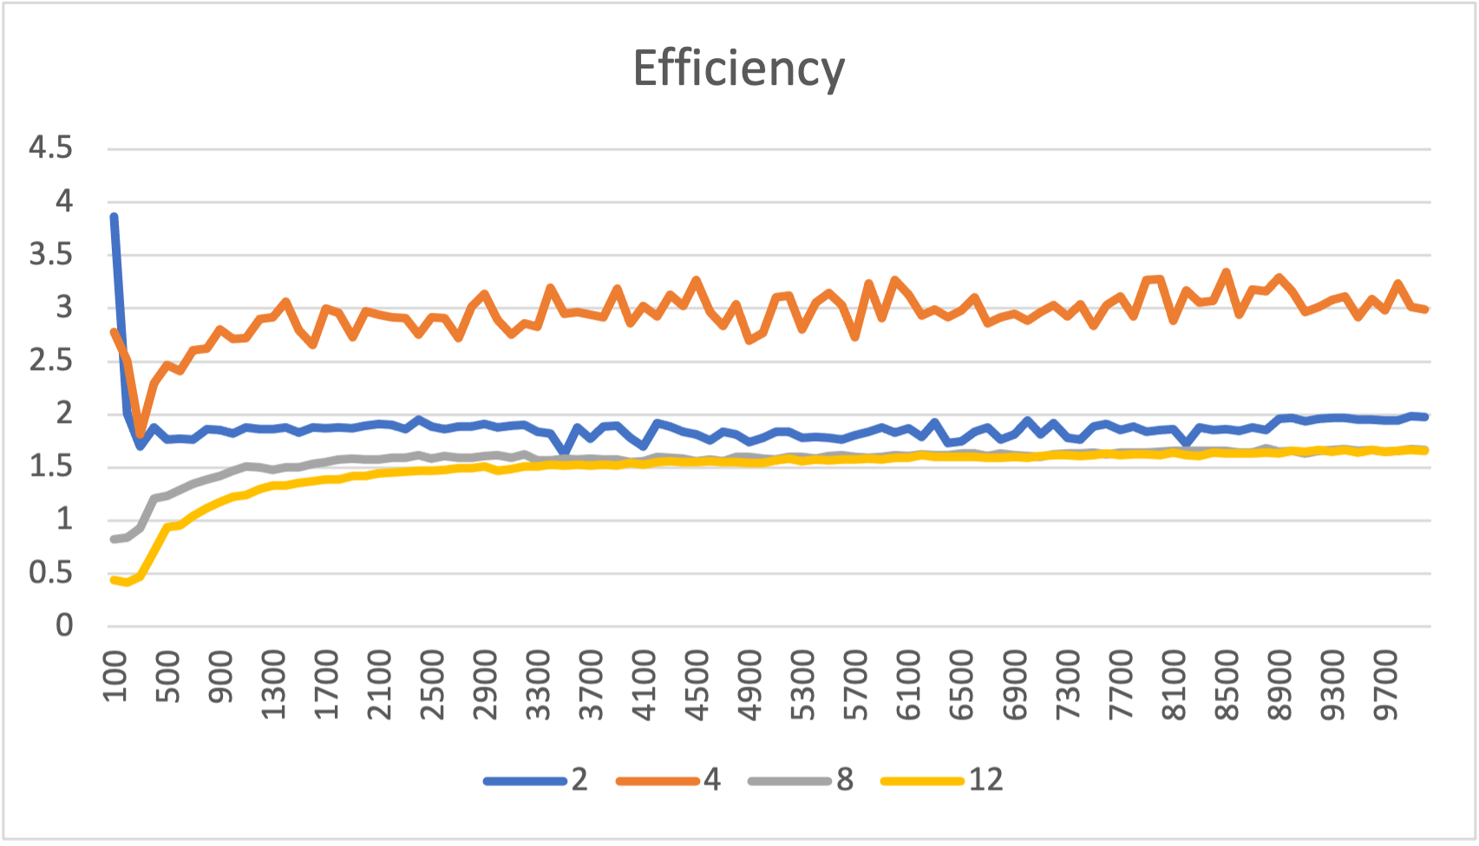
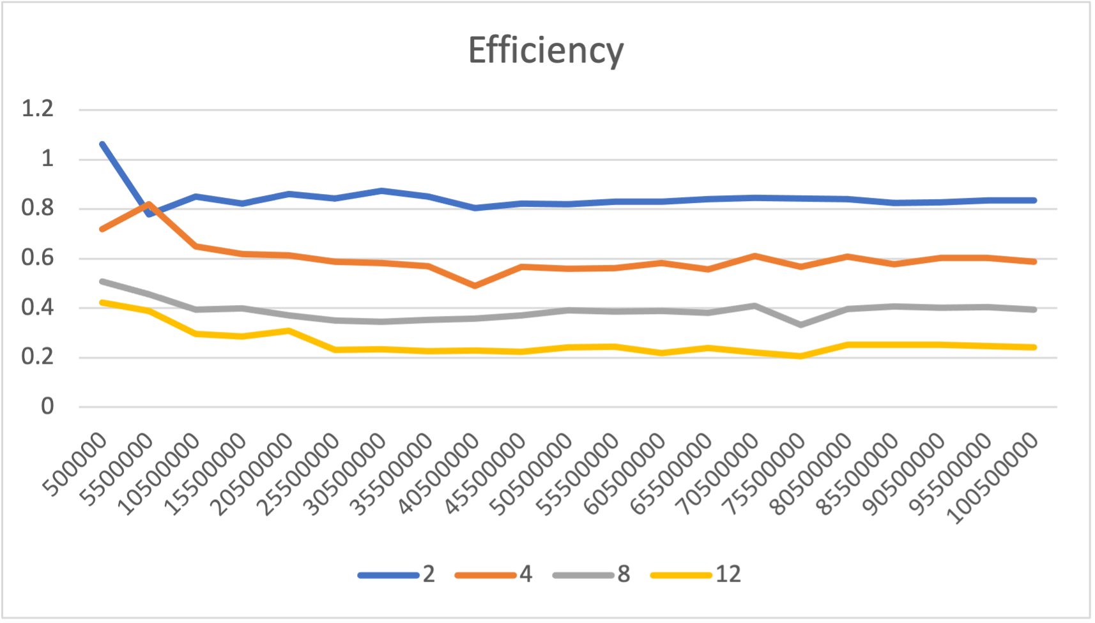
Parallel Matrix Multiplication
Parallel Sum
Notes:
Efficiency is somewhat the same story. It kinda trended up like we would expect with larger problem sizes but not really. And for two threads it dropped from 1.2 down to 1 from the superlinear speedup. Again, we kind of expect this with python and it's plenty good enough for use a teaching tool.

Slide 25
Conclusion
Core directives, clauses, functions implemented
Fit OpenMP style/syntax to Python conventions
Tested our solution with n x n matrix multiplication
Results adequate for teaching parallel concepts
Notes:
In conclusion, we have implemented core OpenMP directives, clauses, and runtime functions in python. We fit the OpenMP style and syntax to the python way of doing things and tried to strike a good balance between the two with some strategic compromises. We tested our python OpenMP using n x n matrix multiplication and the results were more than adequate for our purpose of teaching parallel concepts like concurrency, parallelism, speedup, synchronization to early CS students.

Slide 26
Questions?
Notes:
Thank you, are there any questions?

Slide 27
References
[1] D. J. Ernst and D. E. Stevenson, “Concurrent cs: preparing students for a multicore world,” in Proceedings of the 13th annual conference on Innovation and technology in computer science education, pp. 230–234, 2008.
[2] Y. Ko, B. Burgstaller, and B. Scholz, “Parallel from the beginning: The case for multicore programming in thecomputer science undergraduate curriculum,” in Proceeding of the 44th ACM technical symposium on Computer science education, pp. 415–420, 2013. [3] J. C. Adams, “Injecting parallel computing into cs2,” in Proceedings of the 45th ACM technical symposium on Computer science education, pp. 277–282, 2014.
[4] B. Neelima and J. Li, “Introducing high performance computing concepts into engineering undergraduate curriculum: a success story,” in Proceedings of the Workshop on Education for High-Performance Computing, pp. 1–8, 2015.
[5] J. R. Graham, “Integrating parallel programming techniques into traditional computer science curricula,” ACM SIGCSE Bulletin, vol. 39, no. 4, pp. 75–78, 2007.
[6] R. Brown and E. Shoop, “Csinparallel and synergy for rapid incremental addition of pdc into cs curricula,” in 2012 IEEE 26th International Parallel and Distributed Processing Symposium Workshops & PhD Forum, pp. 1329–1334, IEEE, 2012.
[7] R. Brown and E. Shoop, “Modules in community: injecting more parallelism into computer science curricula,” in Proceedings of the 42nd ACM technical symposium on Computer science education, pp. 447–452, 2011.
[8] J. Adams, R. Brown, and E. Shoop, “Patterns and exemplars: Compelling strategies for teaching parallel and distributed computing to cs undergraduates,” in 2013 IEEE International Symposium on Parallel & Distributed Processing, Workshops and Phd Forum, pp. 1244– 1251, IEEE, 2013.
[9] W. Ahmed, M. M. Muthaher, and J. M. Basheer, “Introducing high performance computing (hpc) concepts in institutions with an absence of hpc culture,” in 2013 Sixth International Conference on Contemporary Computing (IC3), pp. 274–277, IEEE, 2013.

Slide 28
References
[10] S. A. Bogaerts, “Limited time and experience: Parallelism in cs1,” in 2014 IEEE International Parallel & Distributed Processing Symposium Workshops, pp. 1071–1078, IEEE, 2014.
[11] B. L. Kurtz, C. Kim, and J. Alsabbagh, “Parallel computing in the undergraduate curriculum,” in Proceedings of the twenty-ninth SIGCSE technical symposium on Computer science education, pp. 212–216, 1998.
[12] G. Lu, J. Xu, J. Liu, B. Dai, S. Gui, and S. Zhan, “Integrating parallel and distributed computing topics into an undergraduate cs curriculum at uestc,” in 2015 IEEE International Parallel and Distributed Processing Symposium Workshop (IPDPSW), (Los Alamitos, CA, USA), pp. 782–787, IEEE Computer Society, may 2015. 13
[13] S. Ghafoor and M. Rogers, “ipdc workshop.” https://www.csc.tntech.edu/ pdcincs/.
[14] J. M. Bull and M. E. Kambites, “Jomp—an openmp-like interface for java,” in Proceedings of the ACM 2000 conference on Java Grande, pp. 44–53, 2000.
[15] N. Giacaman and O. Sinnen, “Pyjama: Openmp-like implementation for java, with gui extensions,” in Proceedings of the 2013 International Workshop on Programming Models and Applications for Multicores and Manycores, pp. 43–52, 2013.
[16] P. Belohl ˇ avek, “Openmp for java,” 2015.

